Slide 1
Prešov surroundings
Radoslav Vrškový, II.D, GJAR

Slide 2
Branisko, Bachureň, Čergov and Slanské vrchy

Slide 3
Šarišský hrad – Šariš Castle
Built in the mid-13th century
Burnt down in 1678
Precious forest, rich flora

Slide 4
Zbojnícky zámok – Forest Robbers’ Castle
Saltcastle
Built at the end of 13th century
Destroyed in 1715
Interesting botanic finding site

Slide 5
Kapušiansky hrad – Kapušany Castle
Built in the 15th century
Destroyed in 1715
Nice views

Slide 6
Kaštieľ Fričovce – Fričovce Mansion
East-Slovak Renaissance
1623 - 1630
Foreign trees

Slide 7
Pamätník sedliackeho povstania – The Memorial to the Peasants’ Uprising
Top of Furča
Revealed 1938

Slide 8
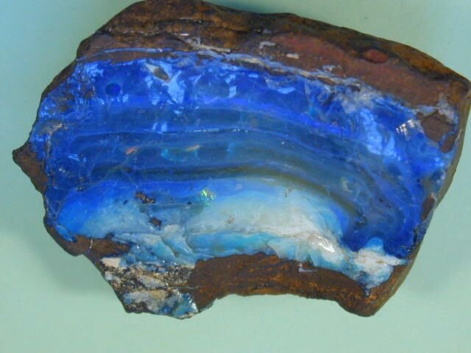
Dubnícke opálové bane – The Dubník Opal Mines
Mining and manufacturing started in the 18th century
Open for public
Bats

Slide 9
Jaskyňa Zlá diera – The “Bad Hole“ Cave
Búče
Without natural light

Slide 10
Thank you for your attention ☺

